Slide 1
Defining Assets
Defining Moats
Strongest
Weakest
Unique AI-based recommendation engine trained on real traveler behavior.
Strong UX/UI design capability for travel-focused interfaces.
Cultural & travel insights from team members with nomadic experience.
Early access to niche traveler communities (digital nomads, solo explorers).
Social media micro-influencer partnerships.
Mobile app development expertise.
Beta testers already engaged from co-working hubs and travel forums.
Connections to local event organizers and tour guides.
Basic seed funding and grants from student entrepreneurship programs.
Limited marketing budget and team bandwidth.
Proprietary AI that learns from user behavior to personalize travel recommendations.
Integration of offline navigation and logistics in a single, cohesive app.
Gamified community engagement that rewards social and cultural immersion.
Early partnerships with co-working spaces and local experiences.
Language adaptation/localization engine for global usability.
Basic freemium monetization—easily replicable.

Slide 2
Defining Core:
AI-driven local experience engine.
Because it evolves with the traveler’s behavior, combining real-time data with community-verified insights, This engine turns passive data into active recommendations, offering a constantly improving and hyper-personalized travel companion.
Tourmate’s AI helps them spend less time planning and more time living, and connecting, during their journey. It directly supports the value proposition of reducing time lost and increasing meaningful experiences.
Every user interaction fine-tunes the AI and adds to a growing data moat. The more travelers use it, the smarter it gets, not just individually but collectively. Competitors starting later won’t have this depth of behavioral data or community trust.

Slide 3
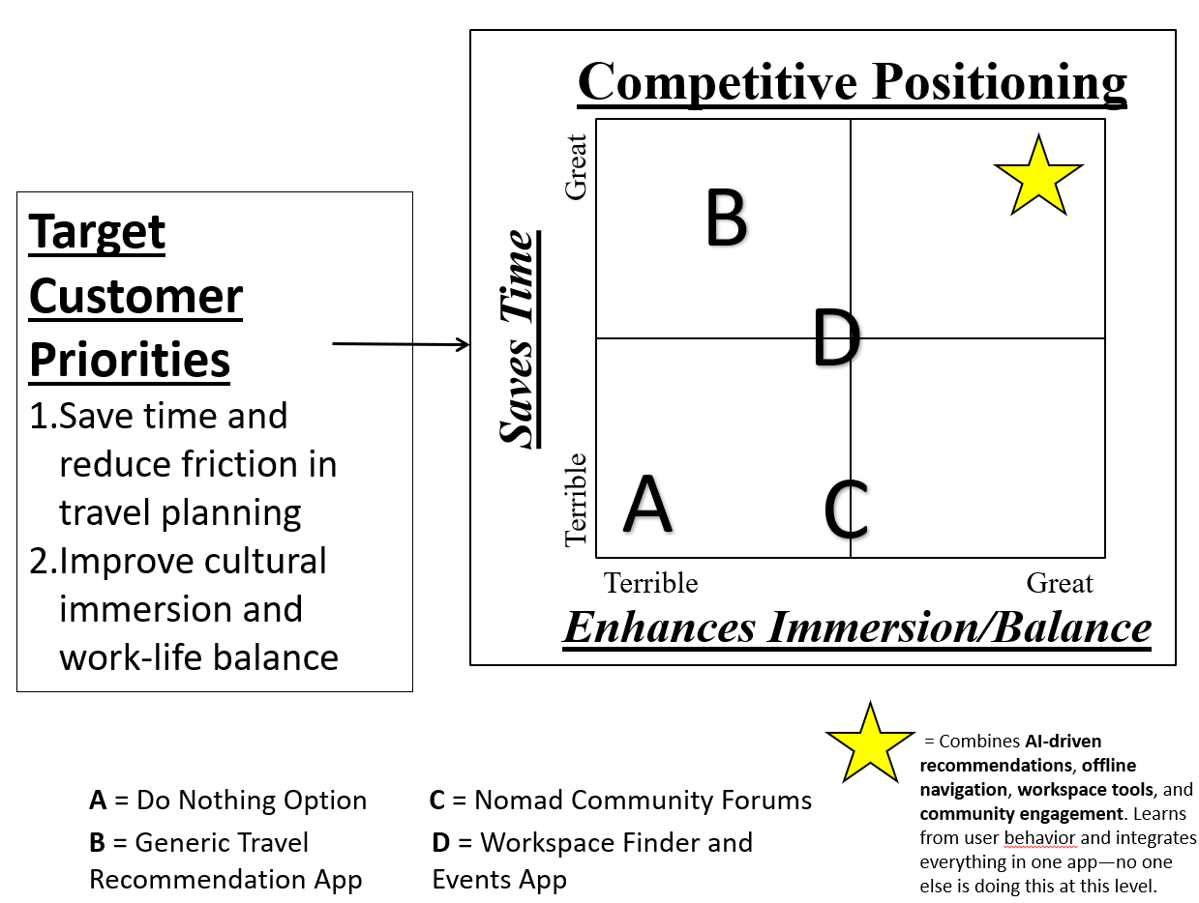
Charting Competitive Position

